Slide 1
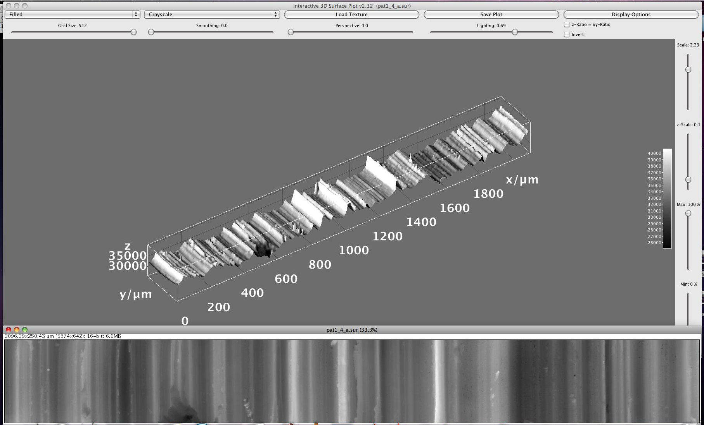


Hands-on Introduction to Mathematica

Slide 2
What is Mathematica?
Primarily a computer program to do symbolic algebra and calculus
Does Plotting, Numerical and Web stuff too.
Very similar to Maple (beloved by Dr. Shenkin)
Mathematica (or Maple) will help you do parts of homework problems and exam questions
I’ll tutor Mathematica, but you may use Maple if you feel more comfortable with it.

Slide 3
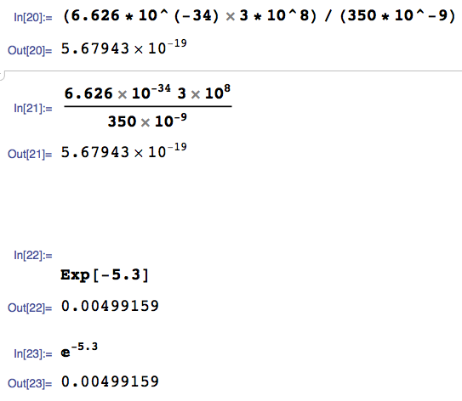
How do I enter a calculation?
Type it in like you would on a calculator
Type <SHIFT><RETURN> to evaluate
Special numbers like e and π have built in symbols and functions. This is e^{-5.3}

Slide 4

Mathematica Search and Documentation is Your Friend
Documentation
Search

Slide 5
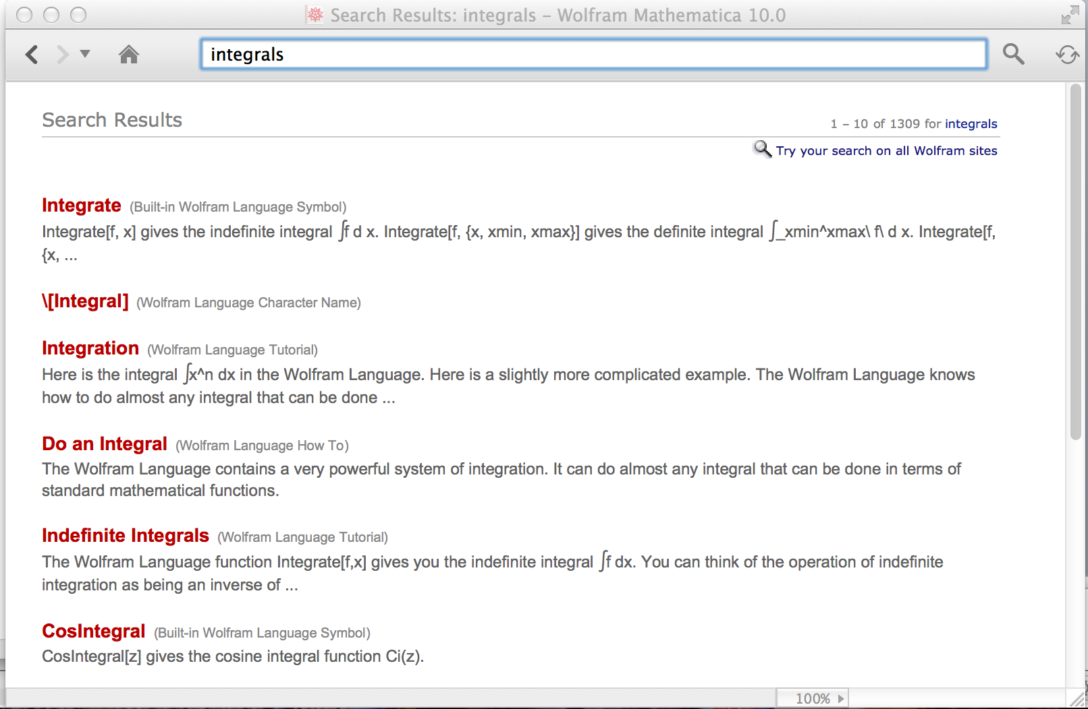
Mathematica Help is Your Friend
How do I do integrals in Mathematica?
A possible search term:
Clickable
results:

Slide 6
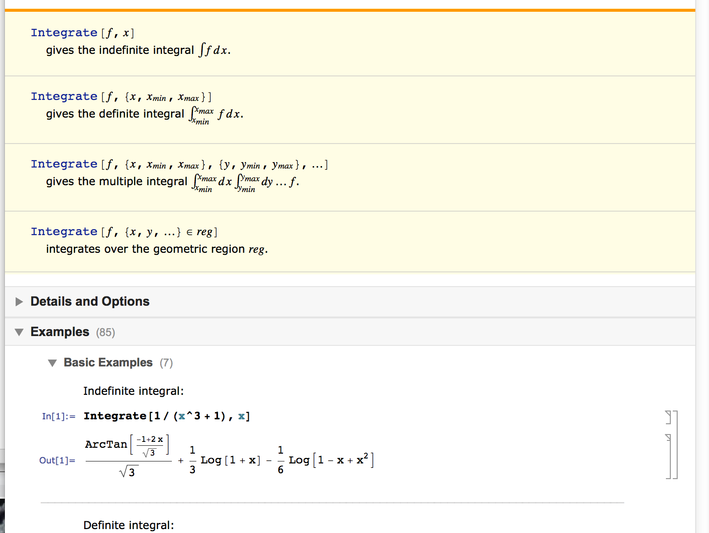
Mathematica Help is Your Friend
Basic structure of a Mathematica help page:
Function syntax. Usually not too helpful for beginners:
Runnable examples!! Very helpful for beginners!

Slide 7
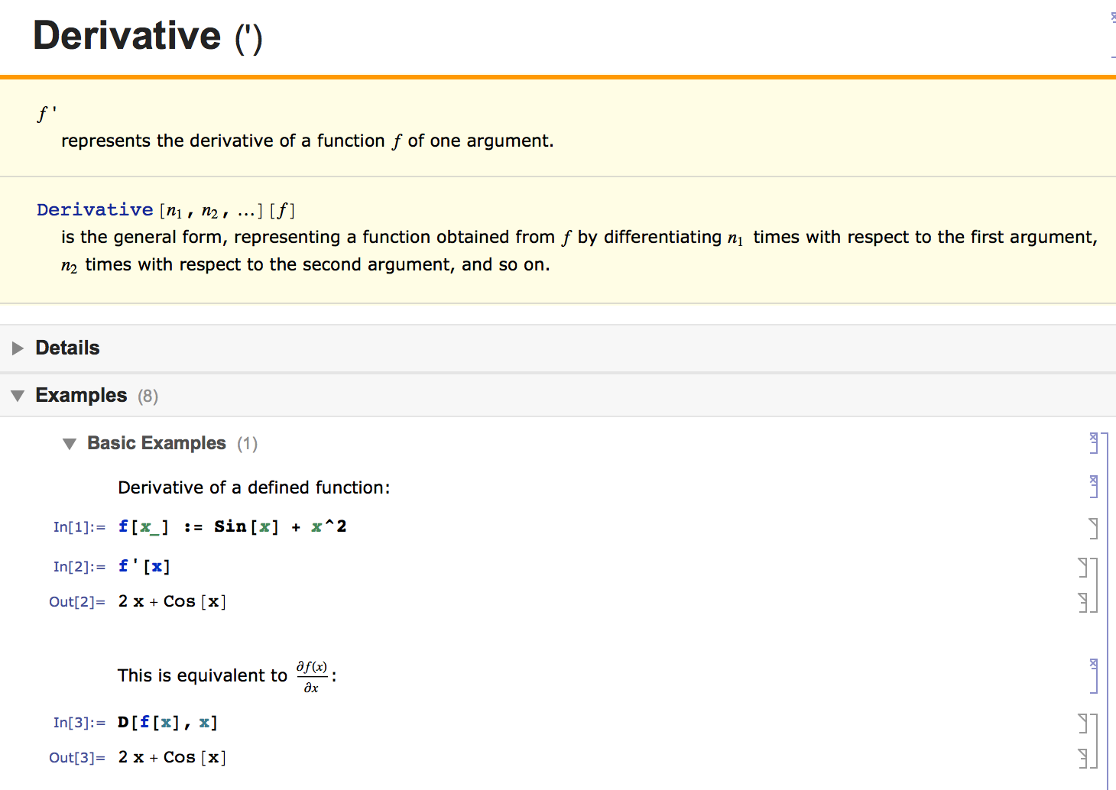
Derivatives in Mathematica

Slide 8
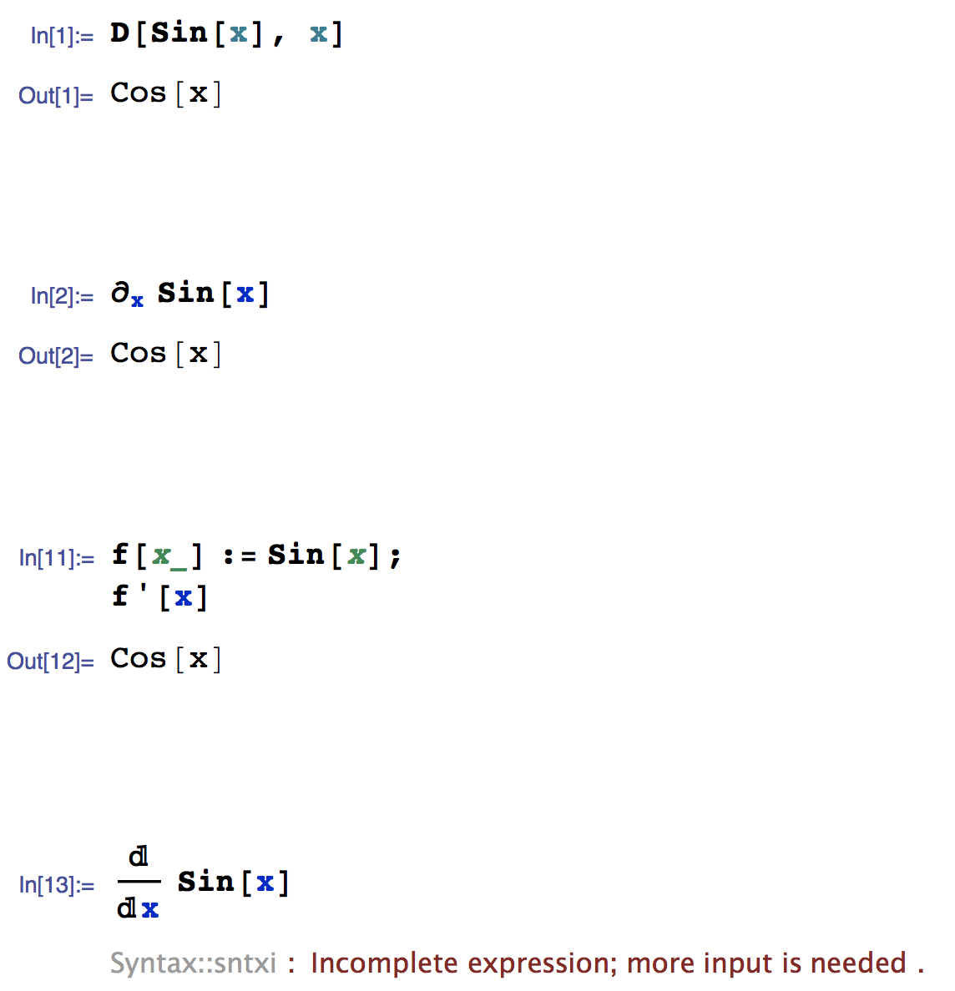
Derivatives in Mathematica
Fastest way to request a derivative
A little fancier notation using special symbol from a palette
When fefining a “symbolic function” you can use ‘ notation
This doesn’t work ☹

Slide 9
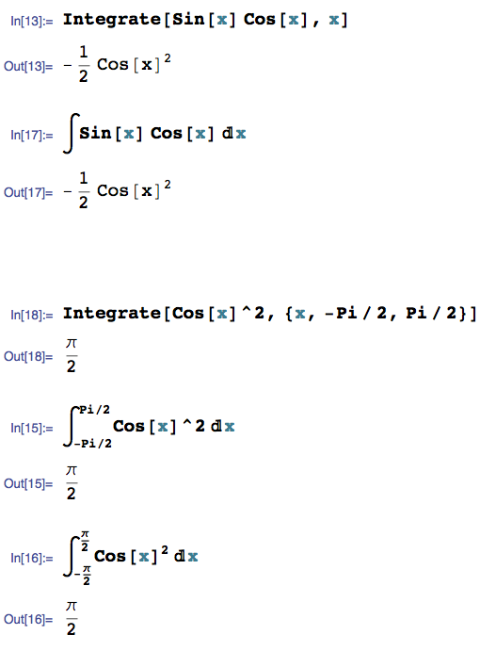
Integrals in Mathematica
Fastest way to type in an integral
A little fancier notation using special symbol from a palette
For definite integrals
Pi means π means 3.1415…
If you like, you can get really fancy with the notation using the palettes

Slide 10
Another Example: Integration with Mathematica: Expectation Values
Say an object’s wave function is:
Give an expression for the variance of x (the object’s location) with respect to the wave functions corresponding its probability distribution.
In other words, evaluate the below and show it is equal to 4:

Slide 11
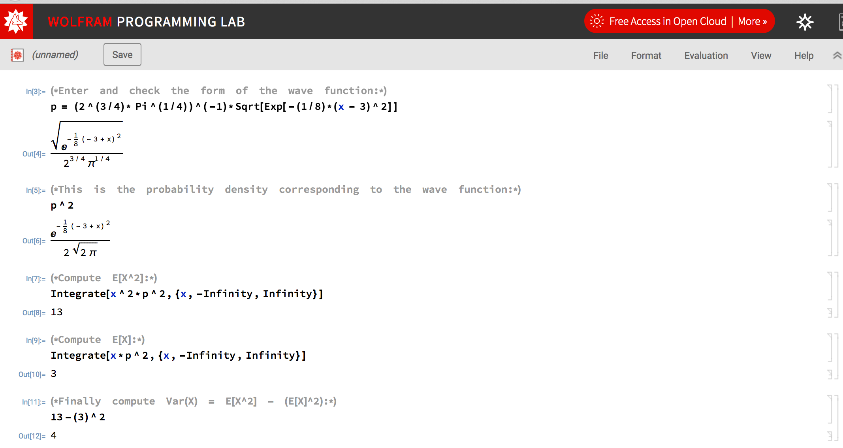
Example: Integration with Mathematica: Expectation Values

Slide 12
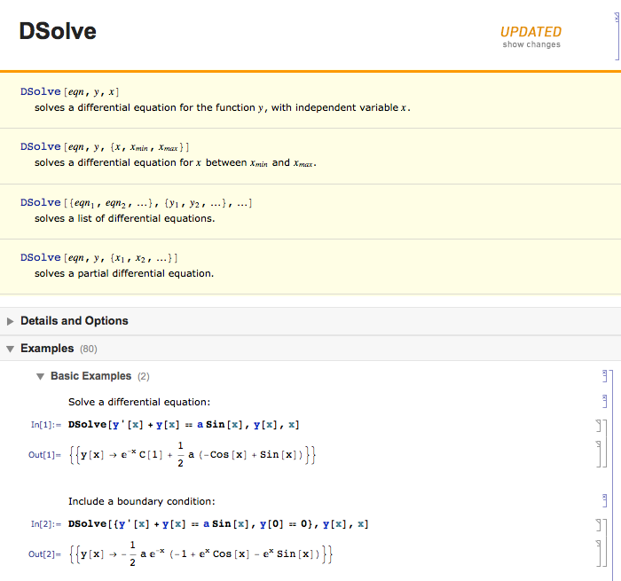
Differential Equations in Mathematica

Slide 13
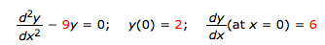
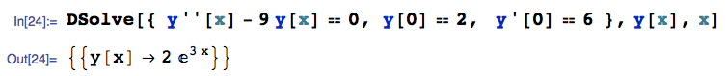
Differential Equations in Mathematica
Lets follow the pattern on the help page and solve one:
Diff eq we want to solve
Extra initial conditions specified to get a specific solution
Solution: y(x) = 2 e^{3x}

Slide 14
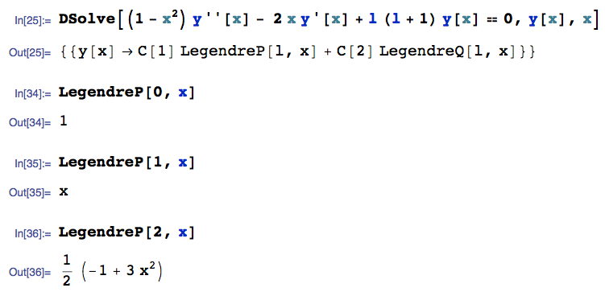
Differential Equations in Mathematica
Since this is a computer, we can ask it to do real fancy stuff too ☺ :

Slide 15
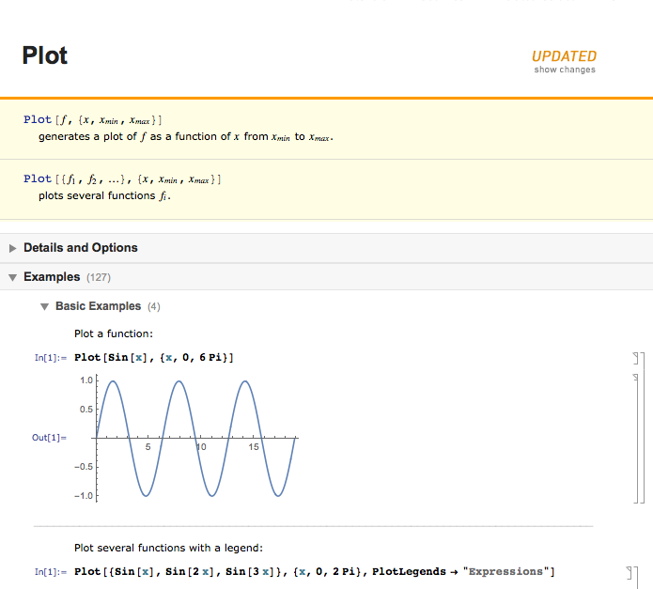
Basic Plotting in Mathematica

Slide 16
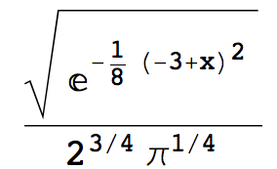
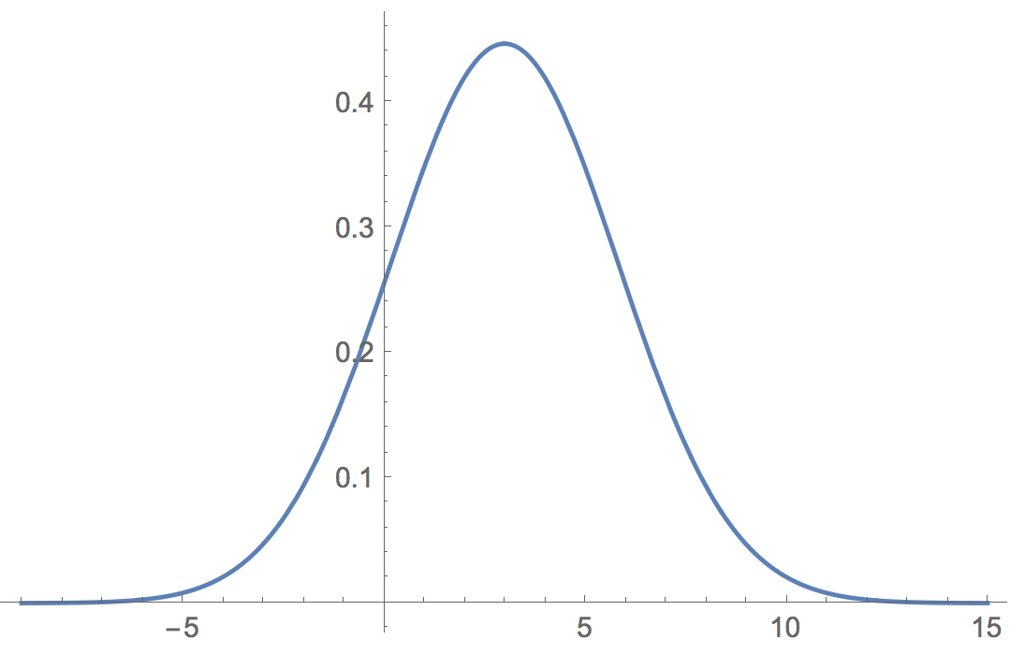
Basic Plotting in Mathematica
Plot the function between -15 and 15:
In[1]:=
p = (2^(3/4)* Pi^(1/4))^(-1)*Sqrt[Exp[-(1/8)*(x - 3)^2]]
Out[1]:=
In[2]:=
Plot[p, {x,-9, 15}]
Out[2]:=

Slide 17
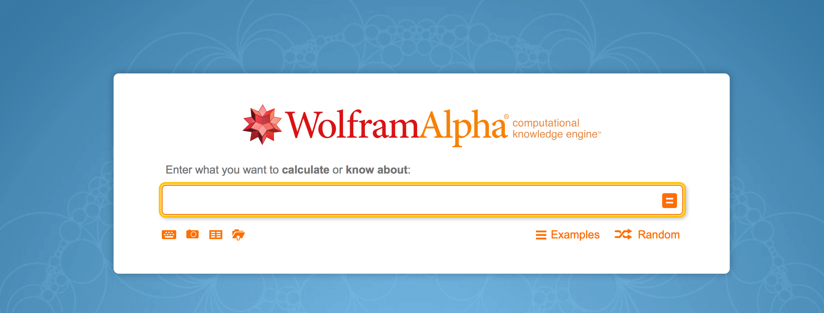
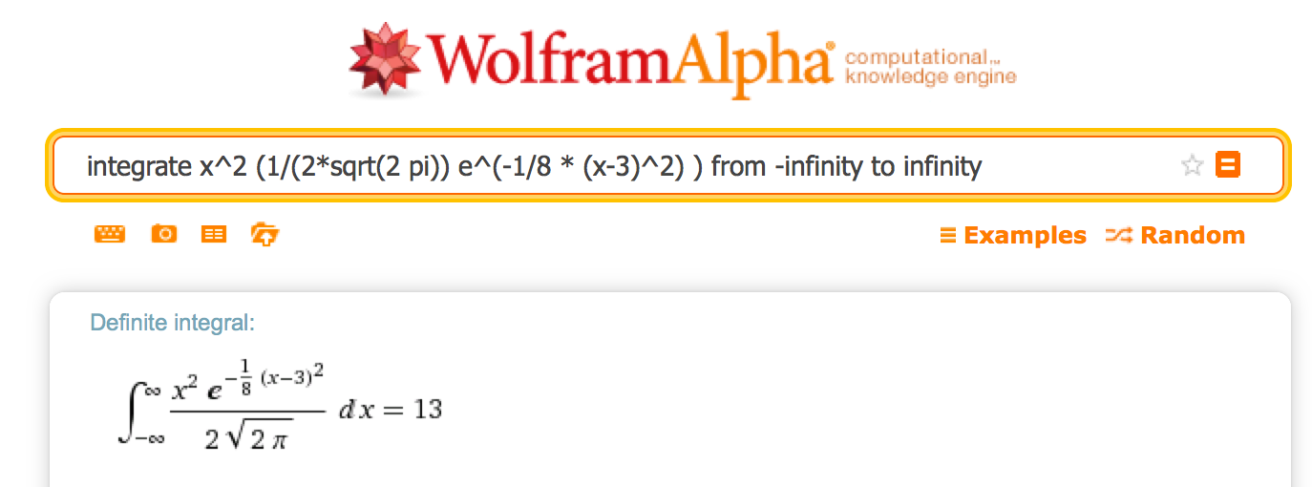
Another Mathematica on the Web For Free!
Hey, we can even use the interwebs: Wolfram Alpha:
http://www.wolframalpha.com/
E[X²]

